Slide 1
Chapter 2 – Conditional Statements
By the end of today’s lesson you should be able to:
Use IF statements in your programs
Choose an appropriate IF statement to use in your code

Slide 2
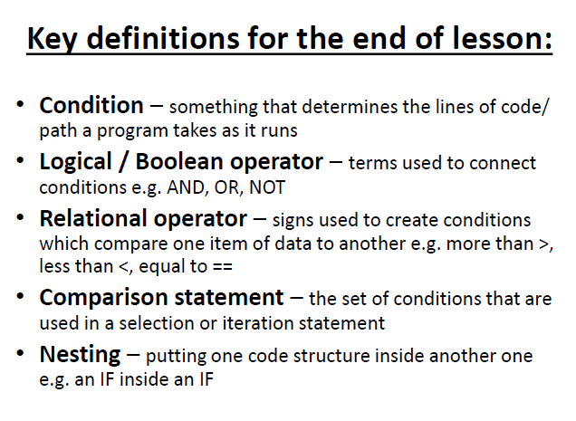

Slide 3
What is a conditional statement?
IFs and CASE statements are conditional lines of code – i.e. a certain pathway through code will be taken depending on the condition(s) of a variable or set of values.
Sometimes there may only be one condition, sometimes there may be several e.g.
‘IF snooze = pressed, I’ll be late for College, otherwise I won’t’.
‘IF I get >70 I’ll get a B, IF I get >80 I’ll get an A, otherwise I’ll re-sit’.
We also often use these for menu type systems when we want a person to choose from a set of options, each of which might jump to a particular section of code/ a different subroutine.
Notes:
Discuss decisions

Slide 4
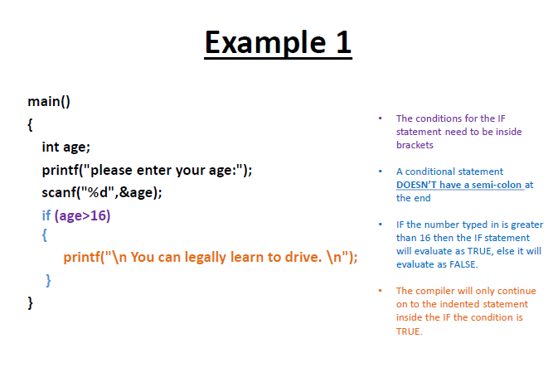

Slide 5
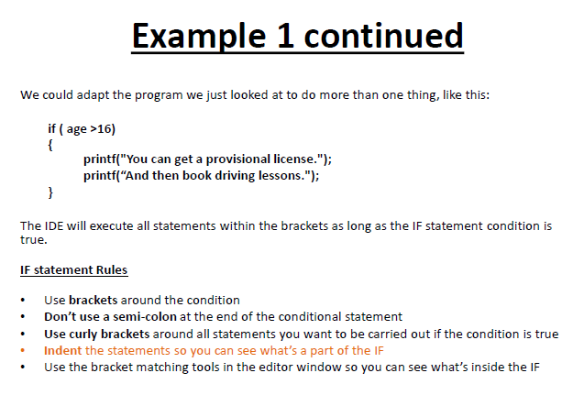

Slide 6
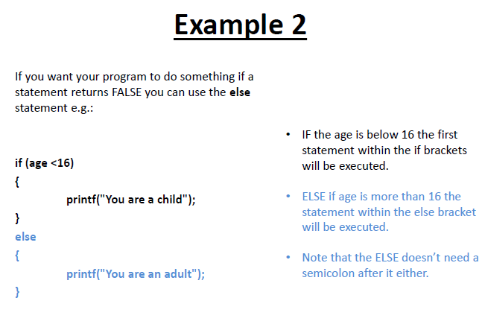

Slide 7
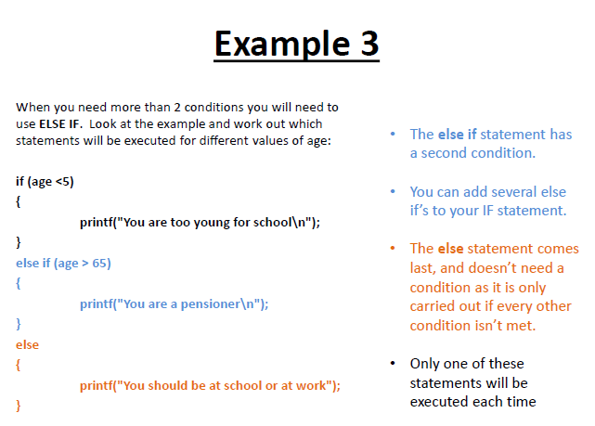

Slide 8
Relational Operators
The following are the relational operators for use with IF statements (and many others you will use in C).
These compare two or more values against each other e.g.
Operator | Meaning
x < y | True IF x is less than y
x > y | True IF x is greater than y
x <= y | True IF x is less than or equal to y
x >= y | True IF x is greater than or equal to y
x != y | True IF x is not equal to y
x == y | True IF x is equal to y

Slide 9
Conditional Rules
When using the equals operator make sure you use two equals signs (==) or the compiler will think you are creating an assignment statement for a variable e.g.:
Using two equals signs is a comparison/ conditional statement e.g. if (age == 18) this means you’re using equals as a relational operator
If we used age = 18 this would be an assignment statement and would store the value 18 in the variable age

Slide 10
Logical Operators
There are also three logical operators you can use to combine tests: AND, OR and NOT.
The correct C syntax for these is:
AND test1 && test2 True only if test1 AND test2 are true
OR test1 | | test2 True if test one OR two are true (including both being true)
NOT ! test1 True only if test1 is false (NOT)
You can chain these conditions together to make more complex conditional tests e.g.
if ( num>0 && num <=5 ) //If num is between 1 and 5 if (num ==5 || num ==0) //IF num is 5 OR num is 0

Slide 11
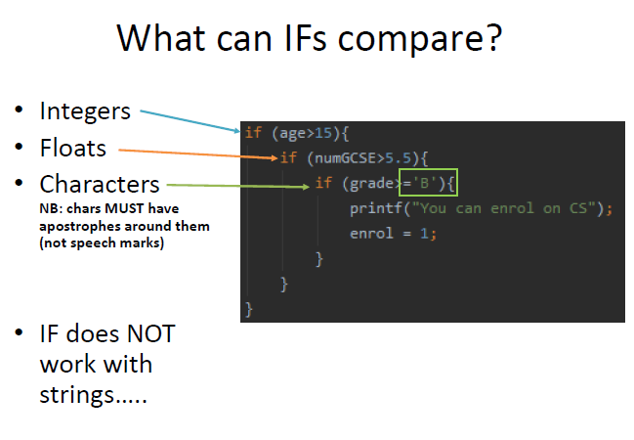

Slide 12
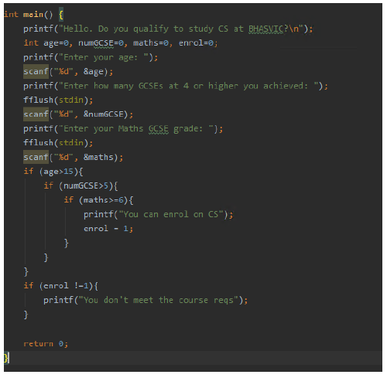

Slide 13
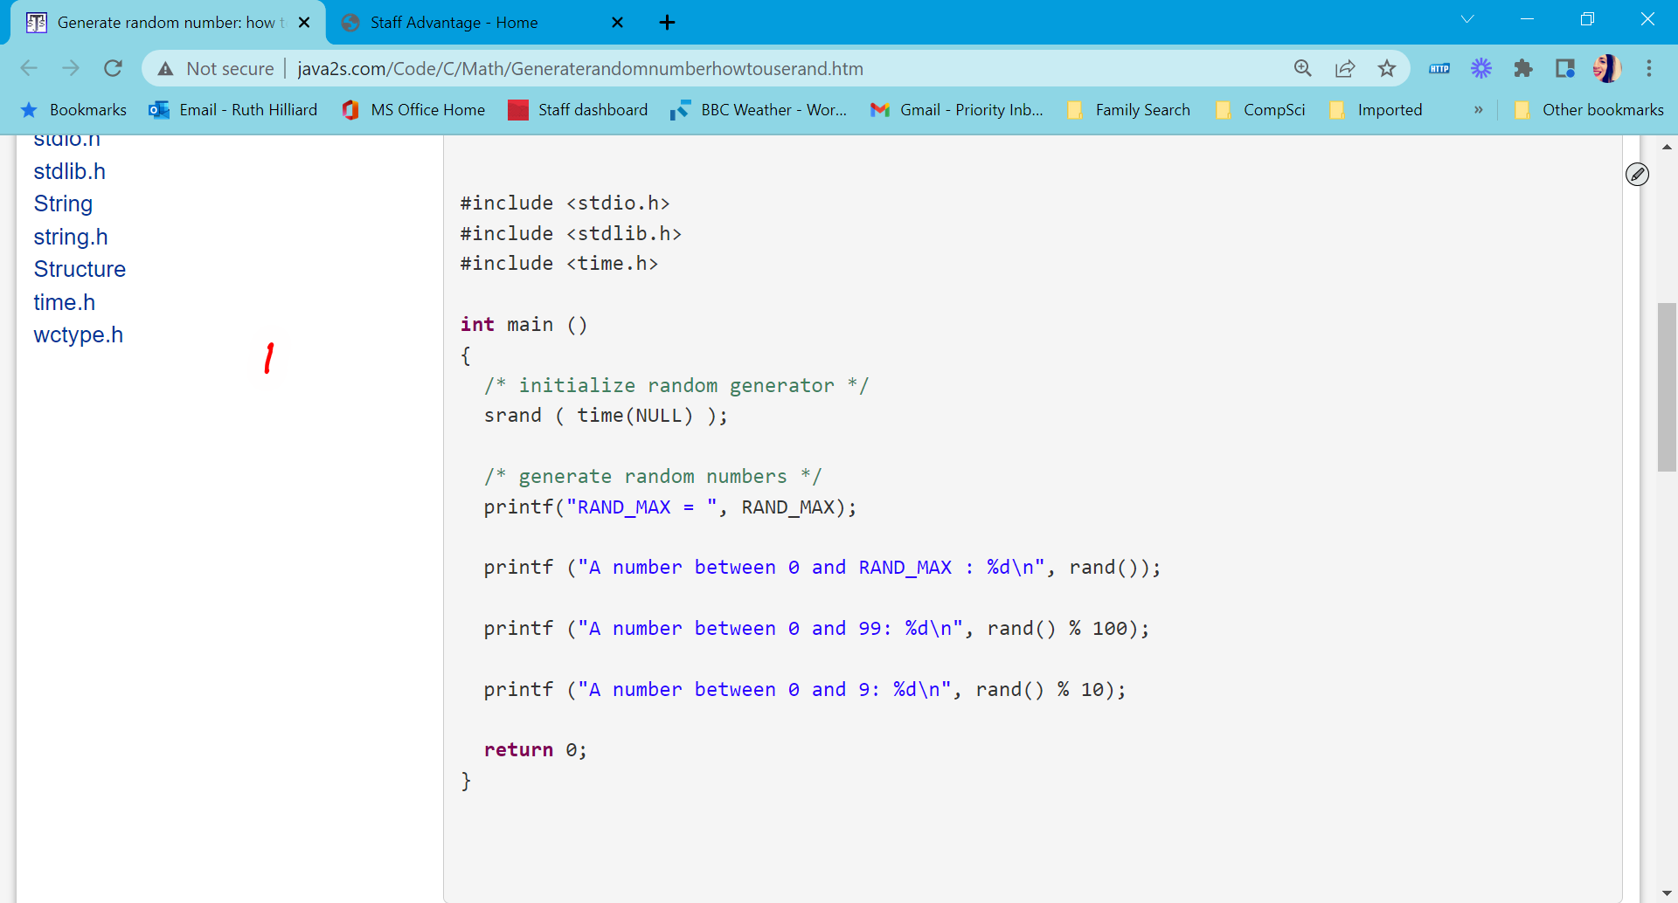
The rand() function for random numbers – try this out
Need to use the time library import
srand() randomises the random function (otherwise you always get the same number)
You call rand() and then specify how many random nums you want
If you wanted the nums 1-100 you would use the first example but add a +1 e.g. rand() % 100+1

Slide 14
Nested IFs
‘Nesting’ = when one control statement is inside another e.g. an IF inside an IF or an IF inside a loop
Sometimes it can be more efficient to nest your IFs and loops so that certain statements are dependent on another running e.g. we only want a path in a program to be followed IF a previous decision is true
IF a student is 15 or over
Only then check IF student has got at least six GCSEs at grade C/ 4 or above (e.g. meets the BHASVIC entry reqs):
And only then IF they have at least a 6/ B in Maths they can enrol on the Computer Science A Level course
Notes:
Students produce a flowchart and an algorithm

